Slide 1
The most interesting profession

Slide 2
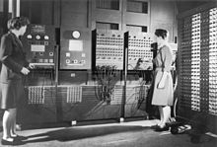
Programmer
Programmers write various programs to make our lives easier.
Betty Jennings and Fran Bilas, part of the first ENIAC programming team

Slide 3
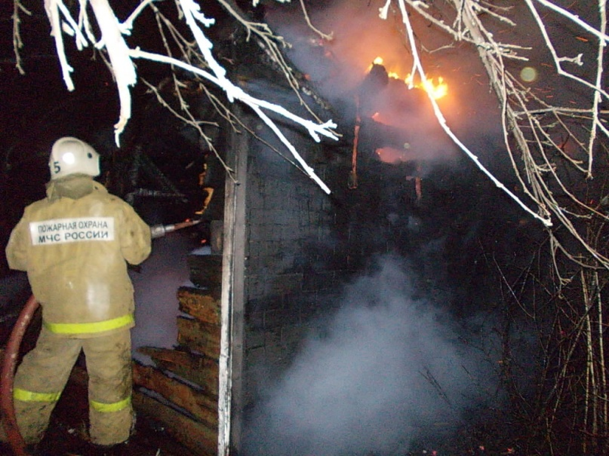
Firefighter
A firefighter is a rescuer extensively trained in firefighting, primarily to extinguish hazardous fires that threaten life, property, and the environment as well as to rescue people and in some cases or jurisdictions also animals from dangerous situations. Male firefighters are sometimes referred to as firemen

Slide 4
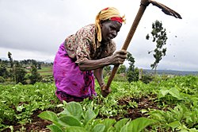

Farmer
A farmer is a person engaged in agriculture, raising living organisms for food or raw materials. The term usually applies to people who do some combination of raising field crops, orchards, vineyards, poultry, or other livestock. A farmer might own the farmed land or might work as a laborer on land owned by others, but in most developed economies, a farmer is usually a farm owner, while employees of the farm are known as farm workers, or farmhands. However, in other older definitions a farmer was a person who promotes or improves the growth of plants, land or crops or raises animals by labor and attention.
A farmer in Chad.

Slide 5
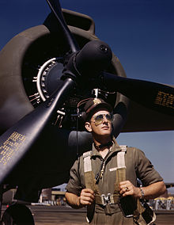
Pilot
An aircraft pilot or aviator is a person who controls the flight of an aircraft by operating its directional flight controls. Some other aircrew members, such as navigators or flight engineers, are also considered aviators, because they are involved in operating the aircraft's navigation and engine systems. Other aircrew members, such as drone operators, flight attendants, mechanics and ground crew, are not classified as aviators.
U.S. Army Air Forces test pilot Lt. F.W. "Mike" Hunter wearing a flight suit in October 1942

Slide 6
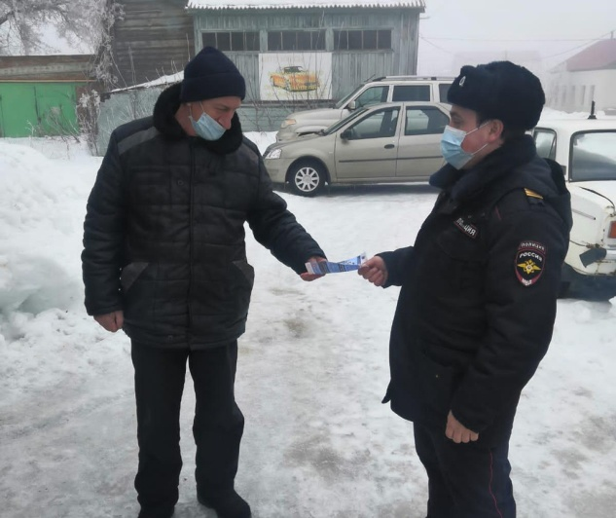

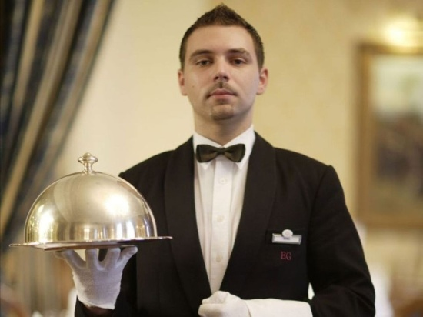



All professions are very, very interesting

